Slide 1



CAPSTONE DESIGN PROJECT
SKKU-DM
Service for the double majors in SKKU
성균관대학교 복수 전공 학생들을 위한 서비스
GROUP
MG세대 (Team G)
TEAM MEMBER
권우진 김재현 박지수 이채은
Notes:
Hello, Team G will now begin the presentation.
We have developed SKKU DM, a service for double major students at Sungkyunkwan University.
Our team members are Woojin, Jaehyun, Jisoo, and Chaeeun, and I am Jisoo.

Slide 2




CAPSTONE DESIGN PROJECT
CONTETNS
1
Motivation & Objective
3
Backend & Infra
5
Challenges
2
Timeline & Roles
4
Frontend with Demo
6
Limitation
Notes:
The presentation will proceed by first explaining the project Motivation and Objectives,
followed by explaining the progress and implementation results for each part.

Slide 3





CHAPTER
01
PROBLEMS with Double Majors
MOTIVATION
Lack of opportunity to interact with the same double major
No official events to make friends unlike primary major
But double majors spend lots of time in second major
Difficulty finding scattered information related to double majors
Graduation requirements
Roadmap recommendations for the second major
Notes:
Our team developed the SKKU DM application because we identified two main problems that our university students face when pursuing double majors
:the lack of opportunity to interact with other students in the same double major program,
and the difficulty in finding scattered information related to double majors.

Slide 4

CHAPTER
01
OBJECTIVE
DM Square
To provide the place for double majors to interact each other
SKKU-DM
To provide the place where double majors can find information easily
Bulletin Board
Notes:
The SKKU DM application primarily consists of DM and Square features –
DM being a chat function to communicate with other double major students and Square being a community space.
And it includes a Bulletin Board service that handles information related to double majors.

Slide 5






CHAPTER
Timeline
02
Timeline & Role
WEEK 1 - 4
WEEK 5 - 11
WEEK 12-13
WEEK 14
Project Topic Refinement and Proposal Writing
Application Development and Infrastructure Deployment
Frontend, Backend Integration & Testing
Final Application Development, Debuging and Preparing Final Presentation
Notes:
From Weeks 1 to 4, our team decided on the project topic and prepared a presentation for the first project proposal.
From Weeks 5 to 11, we continued developing the application and deployed it during the early stages of development.
During this period, our team implemented basic needed pages and APIs.
In Weeks 12 and 13, we integrated the completed pages and APIs and began testing the app for release.
This week, in Week 14, we finalized the application development, debugged the app, and prepared for the Final Presentation.

Slide 6


CHAPTER
Roles - Frontend
02
Timeline & Role
Chae-eun Lee
Woojin Kwon
Implemented Sign-up and login pages
Developed DM and Square pages
Created profile page
Implemented Tag-based search
Developed bulletin board pages
Built CRUD functionality for Posts
Notes:
Next, let me introduce the roles of each team member, starting with the frontend team.
Chae-eun Lee implemented the sign-up and login pages.
She also developed the DM and Square pages and created the User Profile page.
Kwon Woojin implemented the tag-based search functionality and developed the page for the bulletin board.
Additionally, he built the CRUD functionality for posts.

Slide 7
CHAPTER
Roles - Backend & Infra
02
Timeline & Role
Jisoo Park
Jaehyeon Kim
Implemented email verification
Developed Chatting
Created User APIs
Deployed the Project
Implemented Database Schema
Developed APIs for bulletin board and comments
Built Square APIs
Notes:
Next is the backend team.
Jisoo Park, me, implemented the email verification functionality and the chat feature.
I also developed various APIs for users and handled the deployment of the entire project.
Jaehyeon Kim designed the database schema.
He developed APIs for the bulletin board and the comments posted on it.
Additionally, he created the APIs used for the Square page.

Slide 8
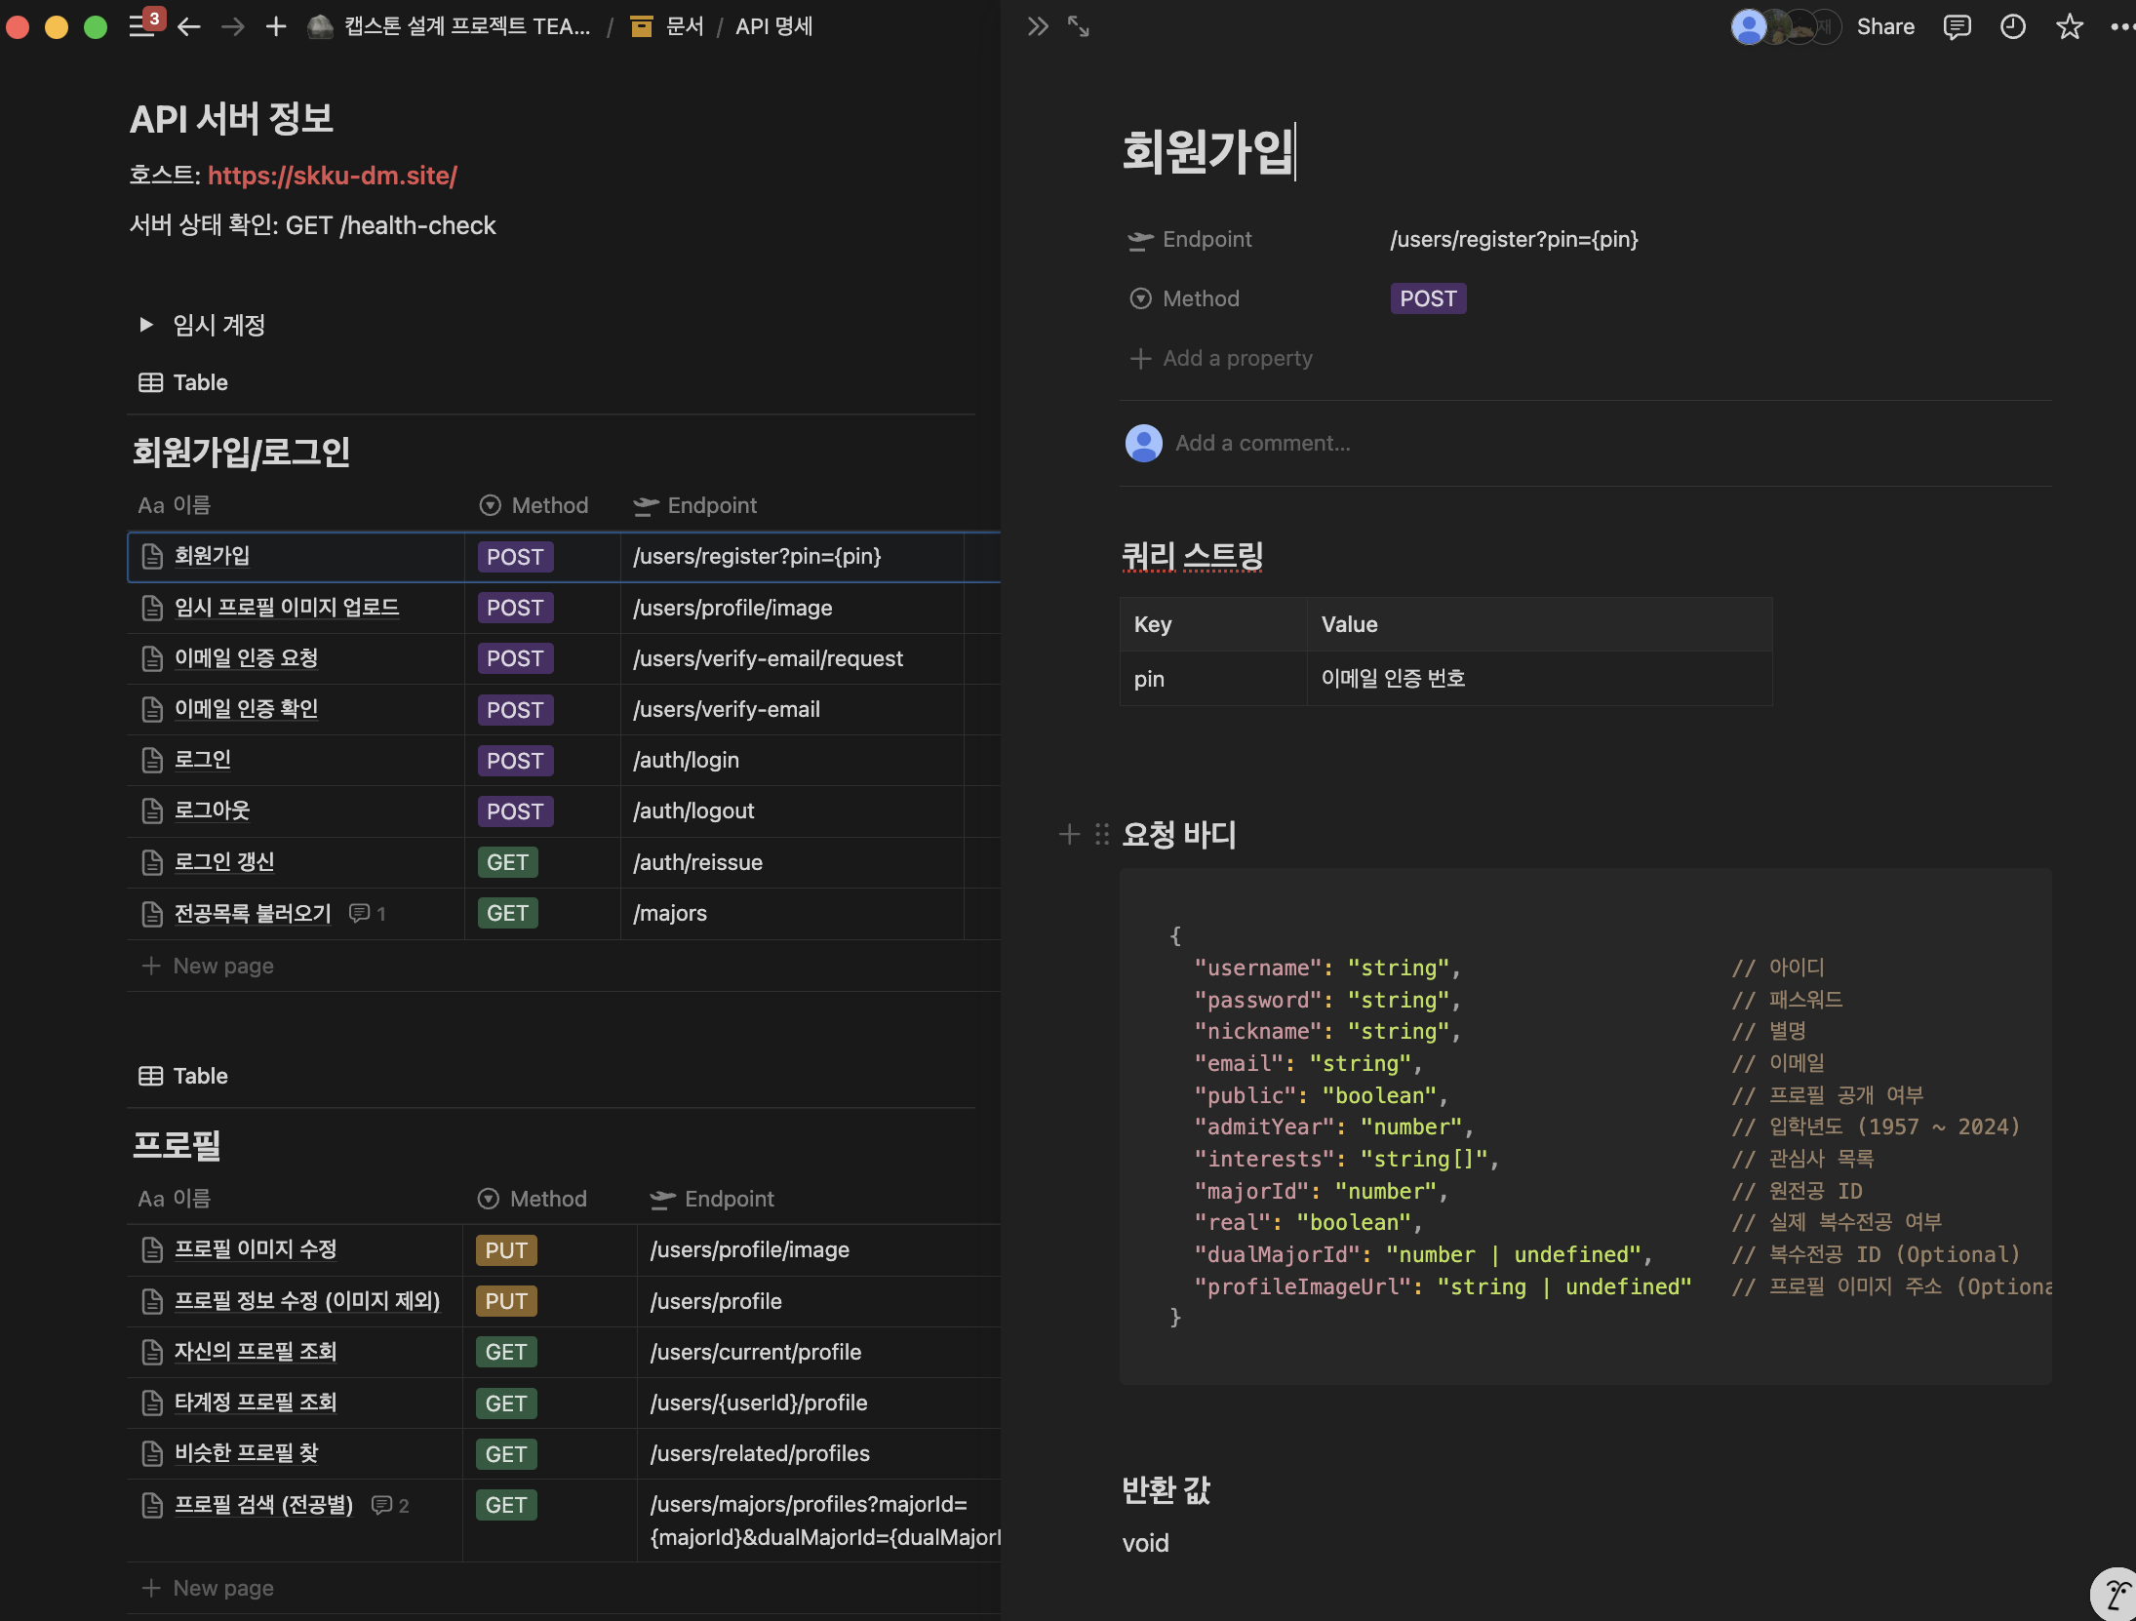
Documentation
CHAPTER
03
Backend & Infra
Notes:
I will explain the overall architecture and functionality of the backend and infrastructure parts.
Our team created API documentation using a Notion page.
As shown in the capture, we documented each API endpoint with its HTTP method, request body,
and return values in a way that makes it easy for team members handling the frontend to understand when connecting to the APIs.

Slide 9

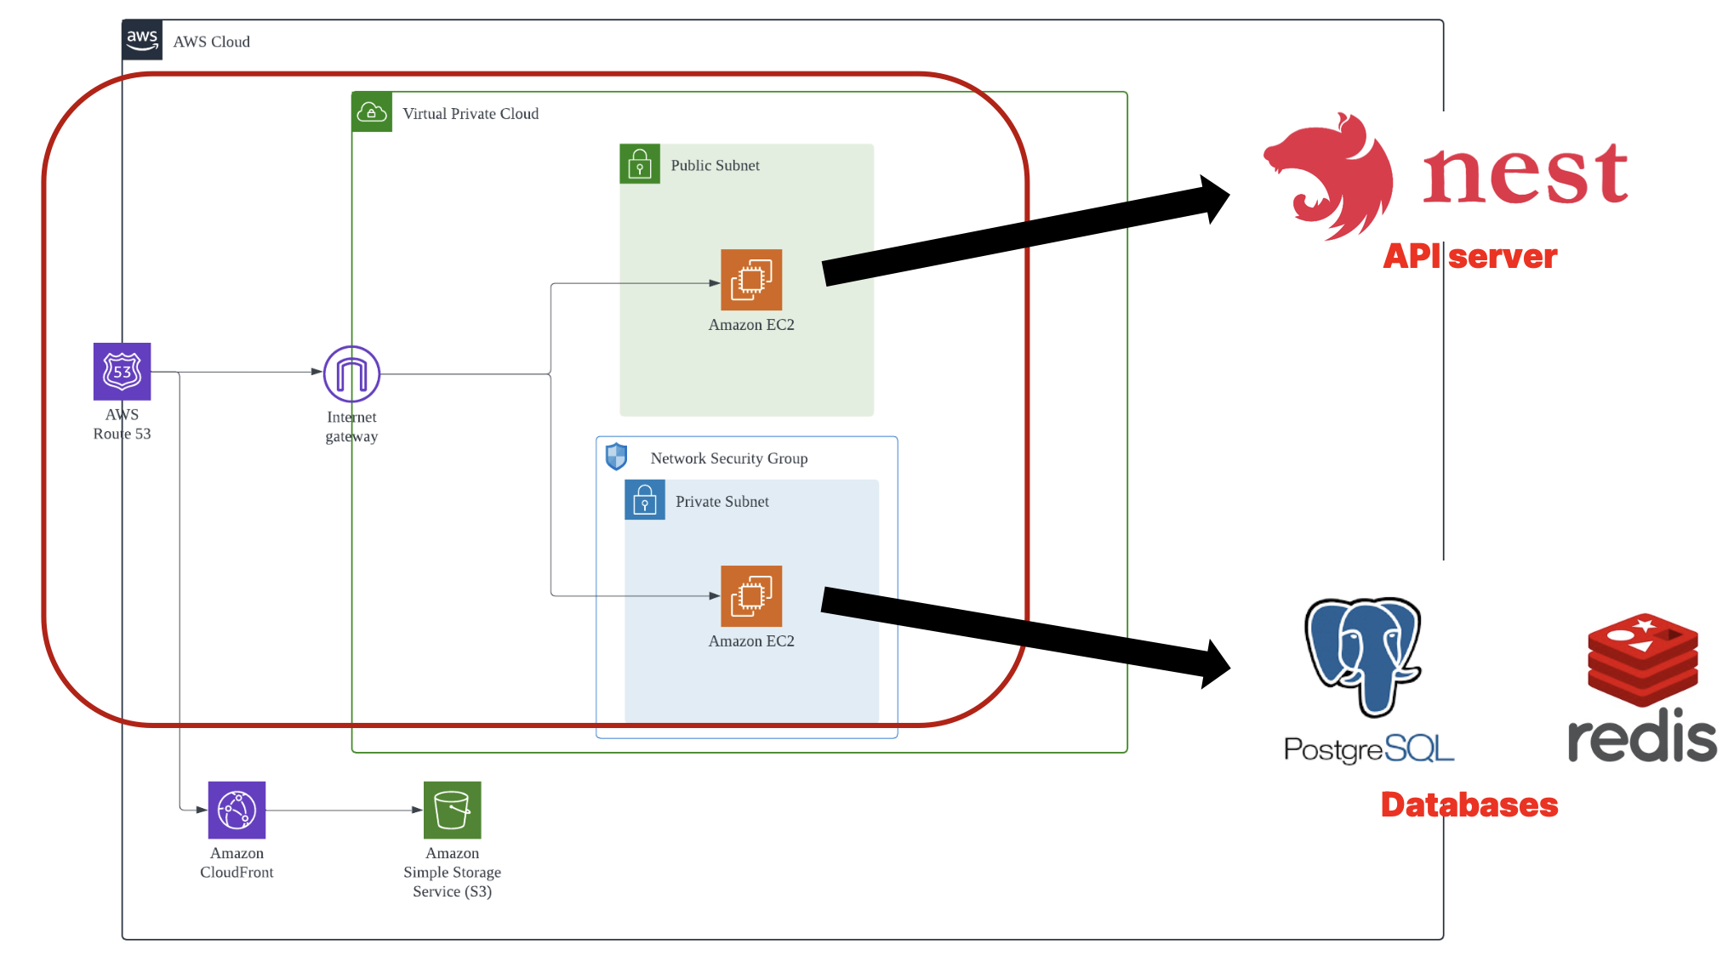
Infrastructure
CHAPTER
03
Backend & Infra
External to AWS Cloud
Notes:
I will now explain the overall infrastructure architecture.
While the infrastructure architecture remains largely unchanged from the initial design,
we incorporated Firebase, an external service outside of AWS Cloud, to facilitate chat functionality implementation.
I will explain this in detail later in the challenge chapter.

Slide 10
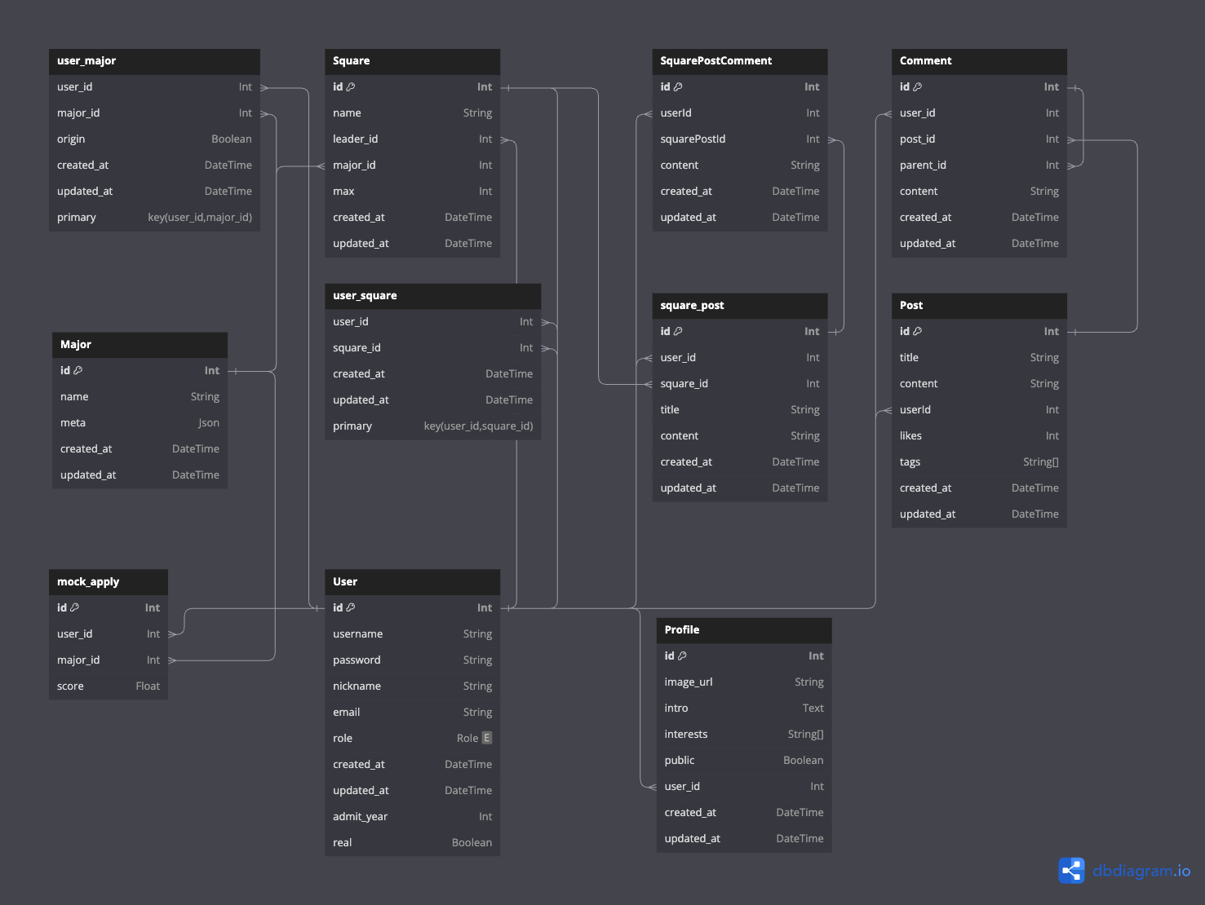
Databases - PostgreSQL
CHAPTER
03
Backend & Infra
Notes:
Next is the final version of the PostgreSQL schema.

Slide 11
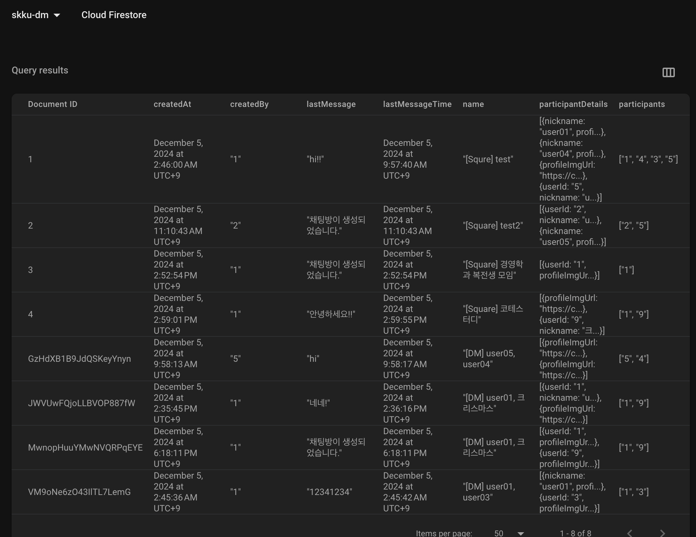
Databases - NoSQL
CHAPTER
03
Backend & Infra
Notes:
Next is the list of documents stored in FireStore for chat information.

Slide 12
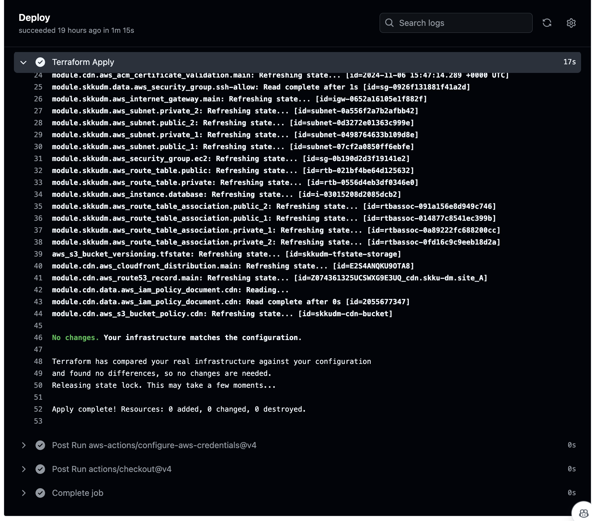
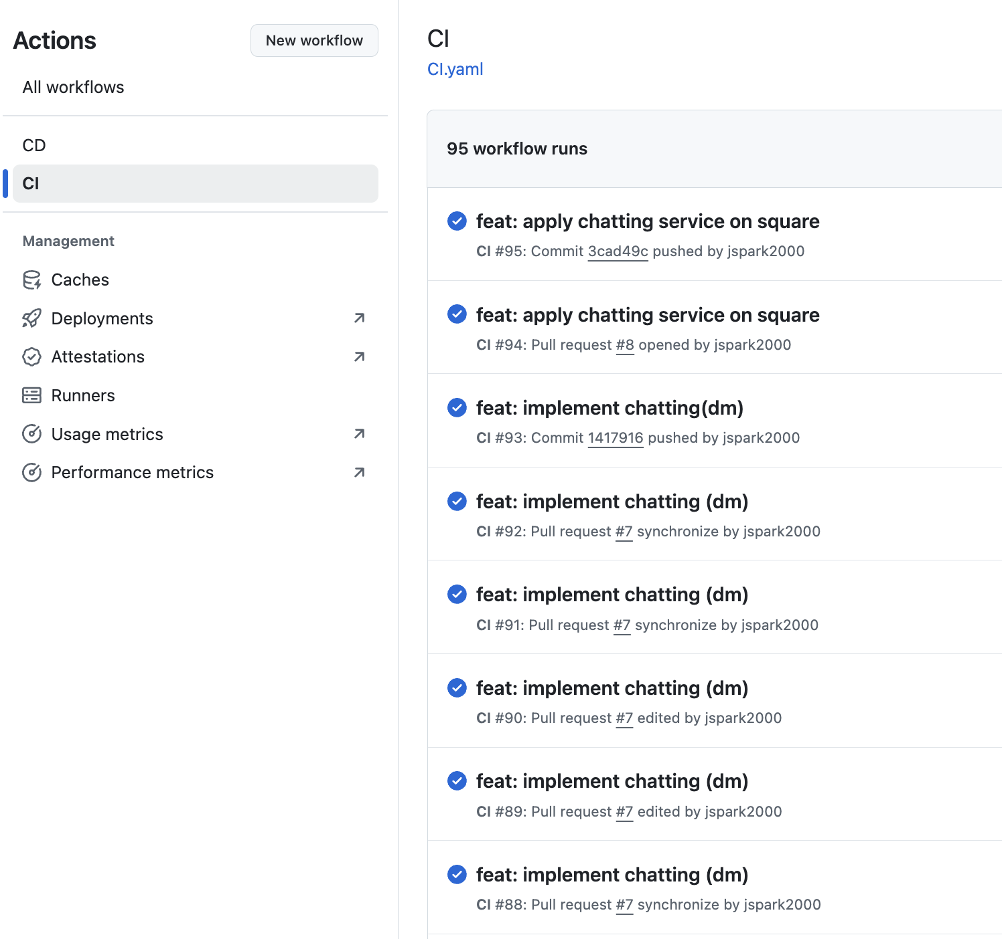
CI / CD
CHAPTER
03
Backend & Infra
Notes:
Our team implemented CI/CD pipelines using GitHub Actions that trigger when changes occur in the main branch or when manually activated by repository administrators.
The CI pipeline performs type checking on backend code, runs project builds, and executes test code for verification.
The CD pipeline applies infrastructure changes to AWS Cloud using Terraform,
builds the backend server as a Docker image, and updates the server with the latest changes.

Slide 13
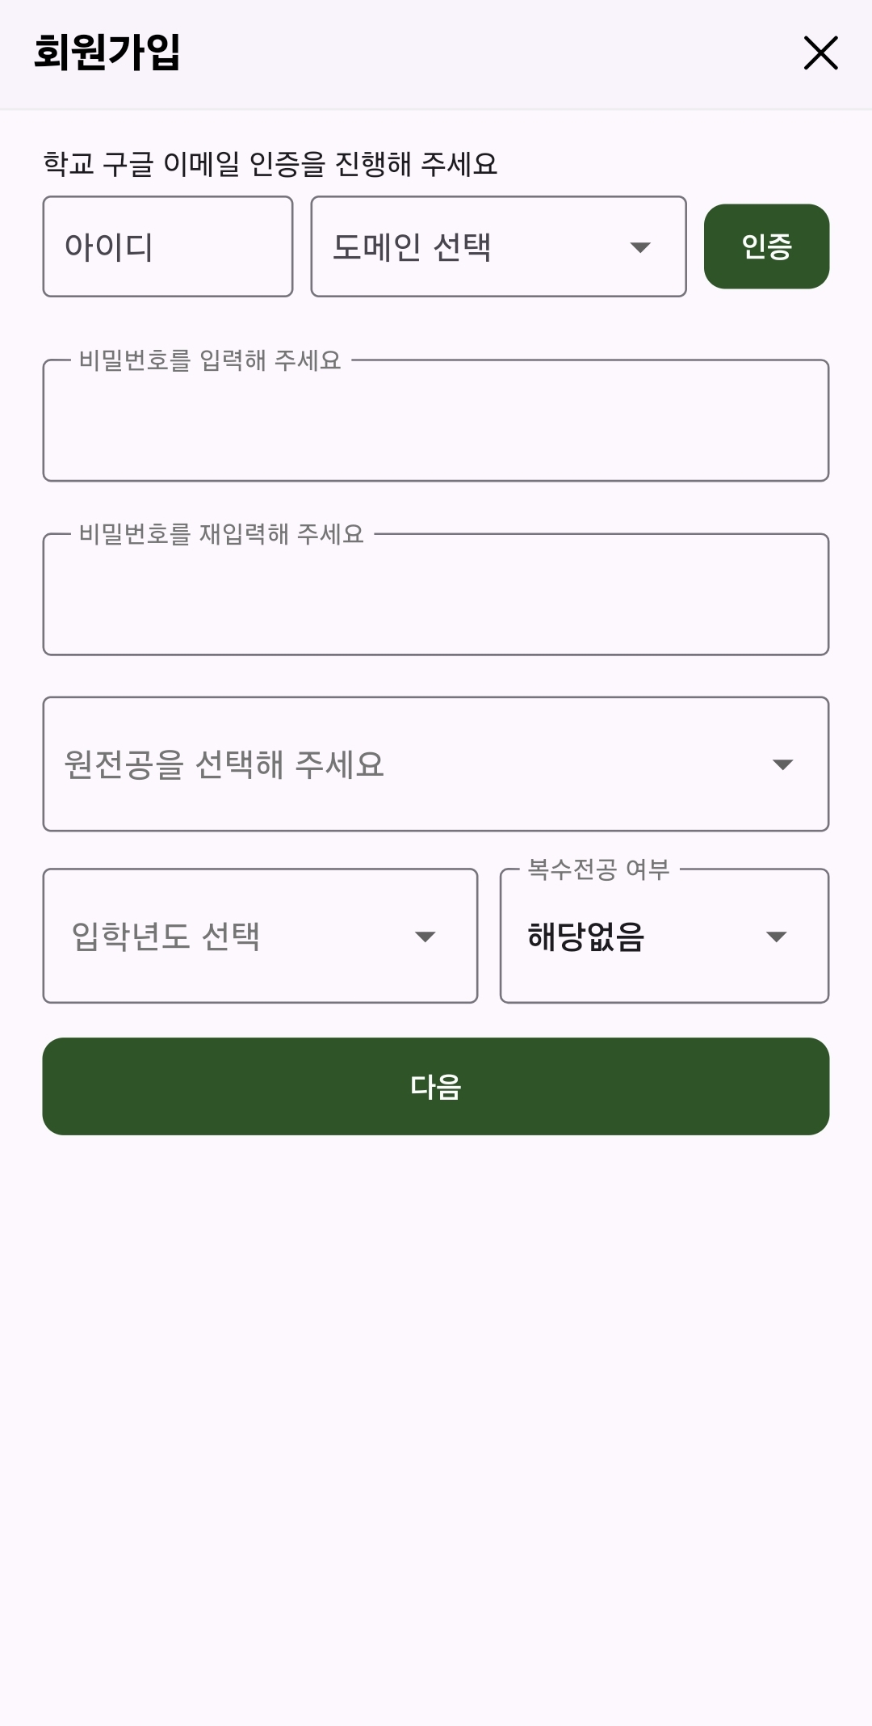
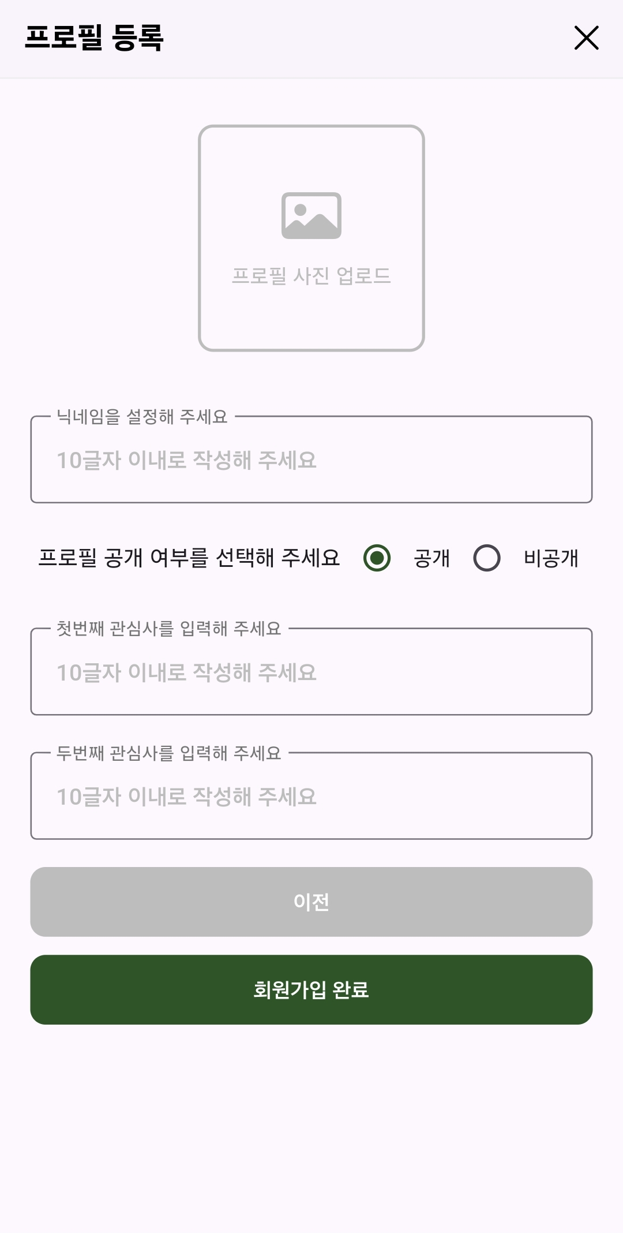




Register & Login
CHAPTER
04
Frontend with Demo
Email Authentication
Authenticate via @g.skku.edu
Enter Personal Information
Users’ student number, primary major, and second major
Notes:
Now, I will introduce the final application and demo video.
First, to join the SKKU-DM, you need to go through authentication through the school's Google email.
Then, enter information such as primary major, double major, and interests.

Slide 14
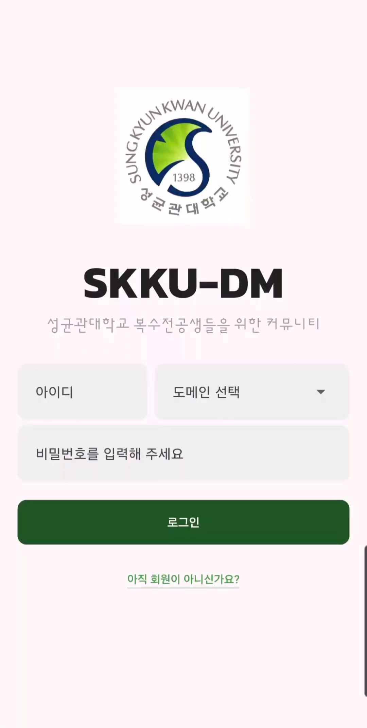
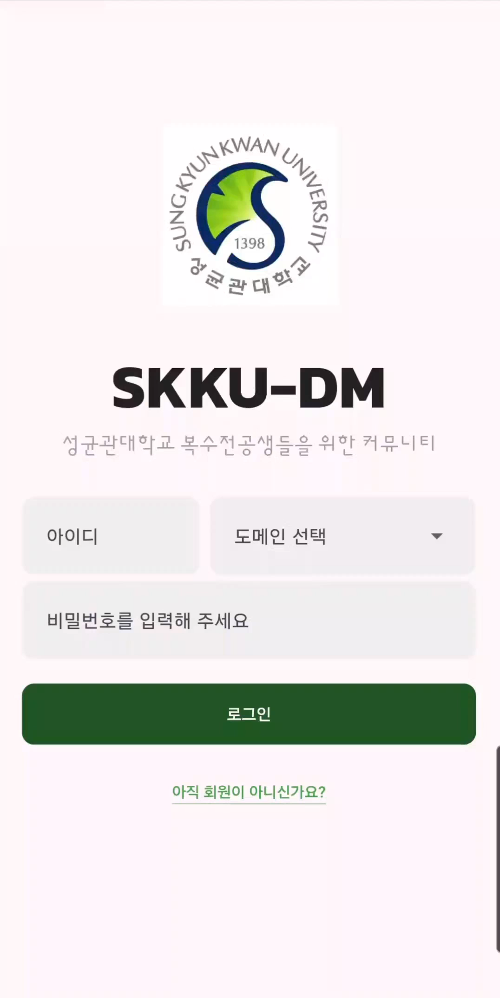
Register
Login
CHAPTER
04
Frontend with Demo
Notes:
This is Demo video of registering and login to SKKU-DM.

Slide 15
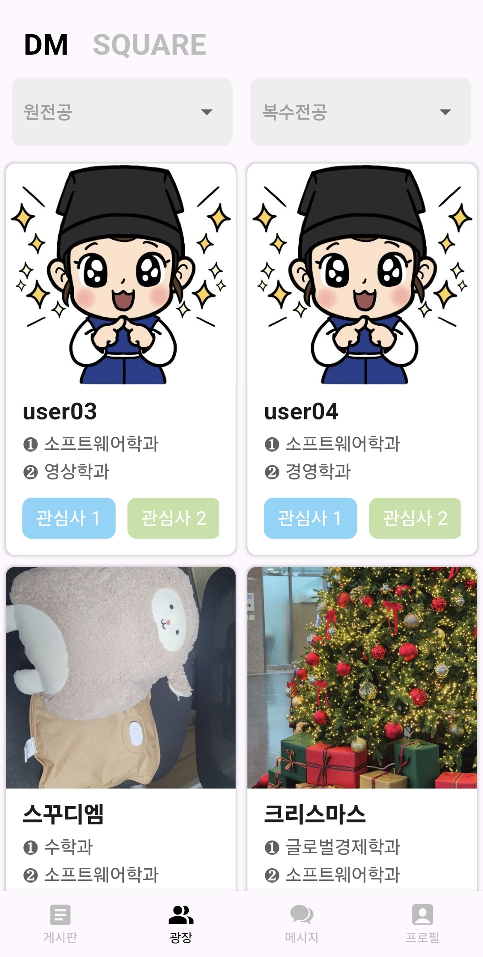
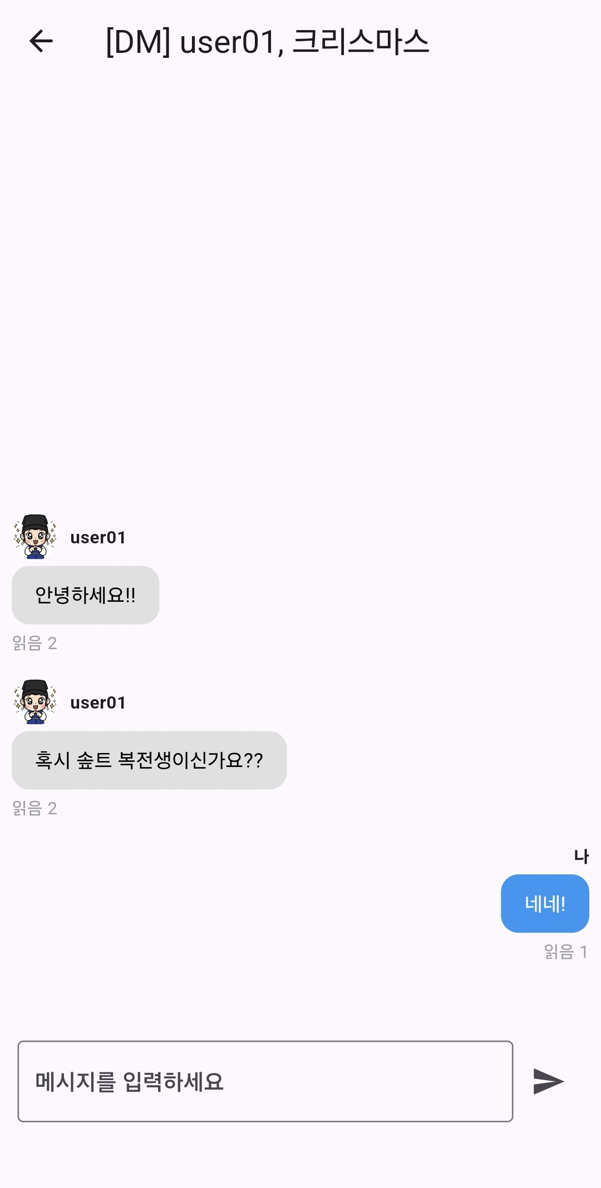

DM & Messages
CHAPTER
04
Frontend with Demo
Search Users and send Messages
You can search users by major and send direct messages.
Private Profile
If you don’t want to be in DM list, you can change your profile into private.
Notes:
In the DM pages, you can search for users by major.
For example, you can only look up users who have double majors in computer engineering.
If you keep your profile private, it will not be exposed to this DM list.
Then, you can send a message by clicking on the profile you want to try to interact with.

Slide 16
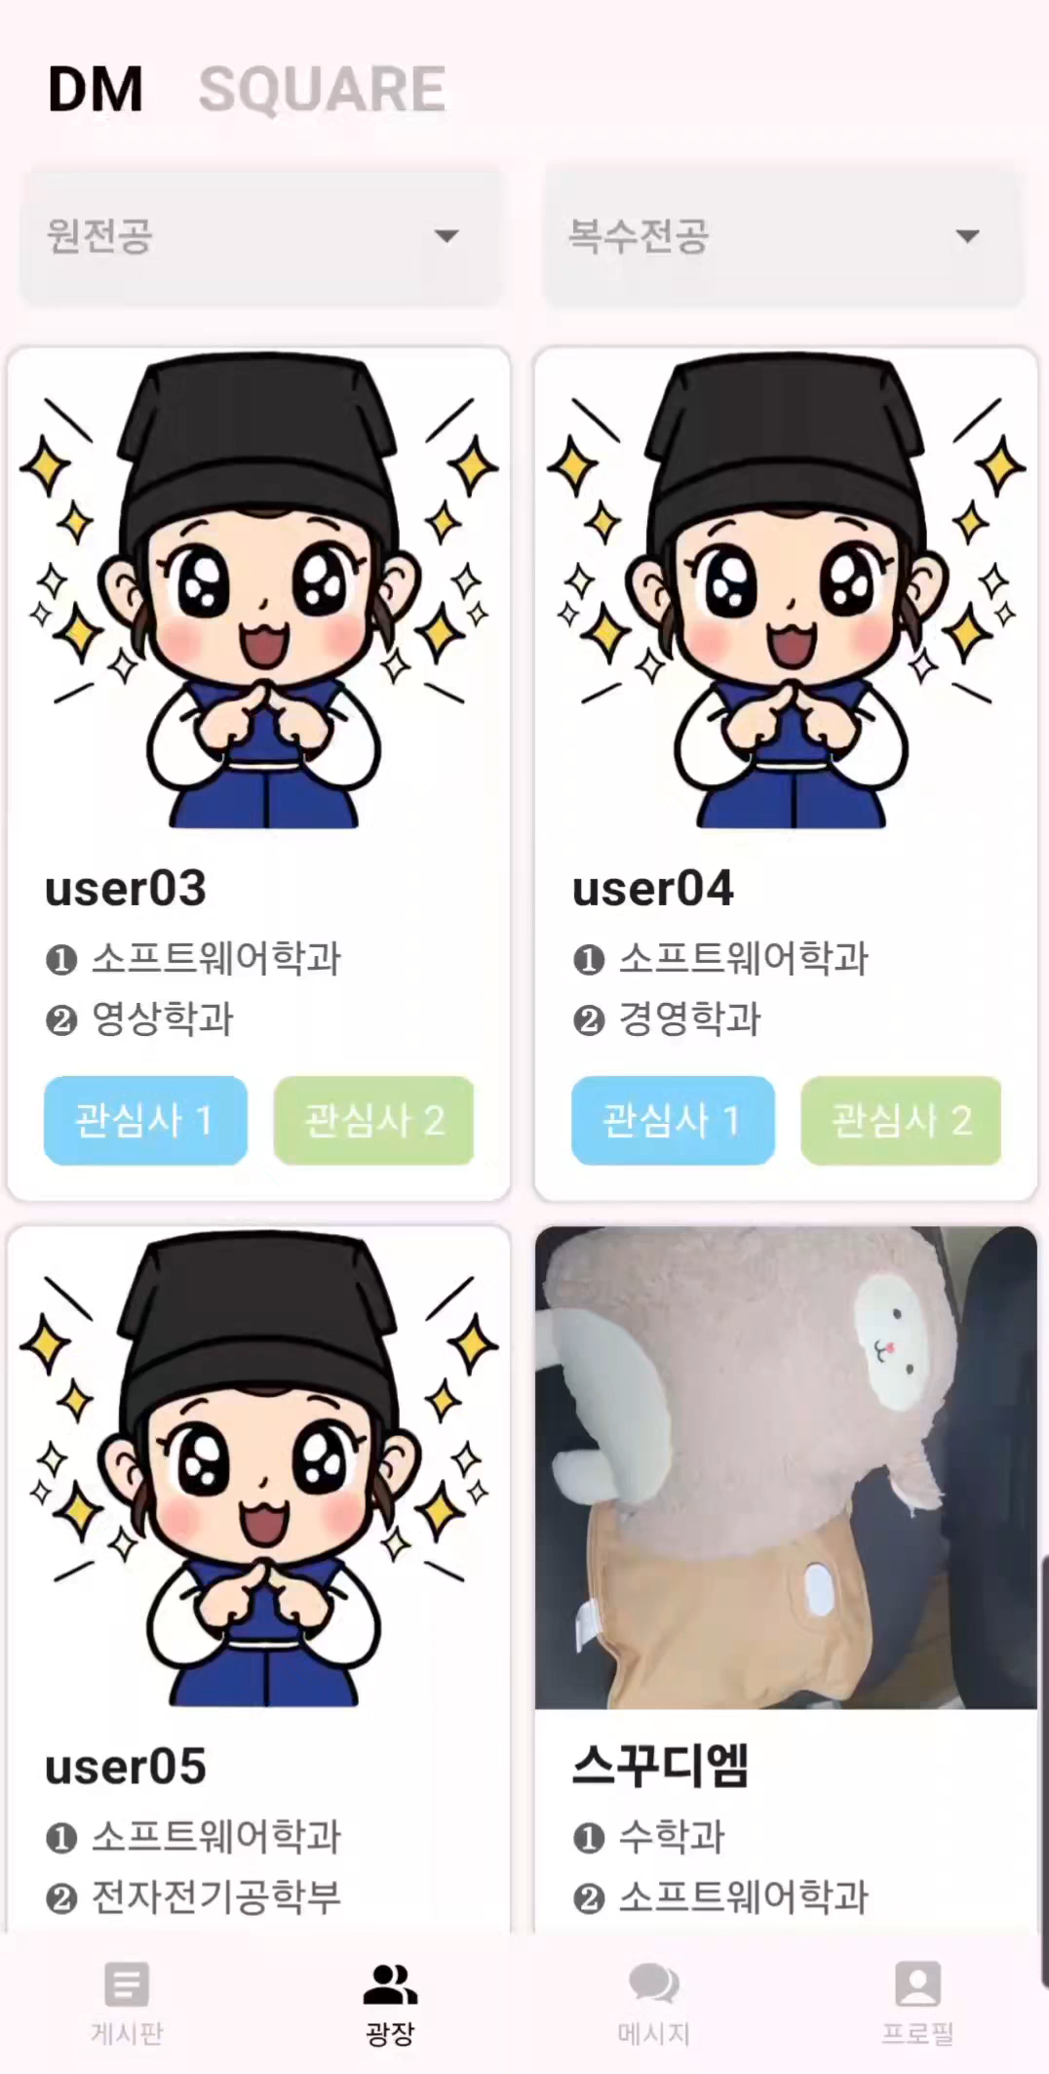
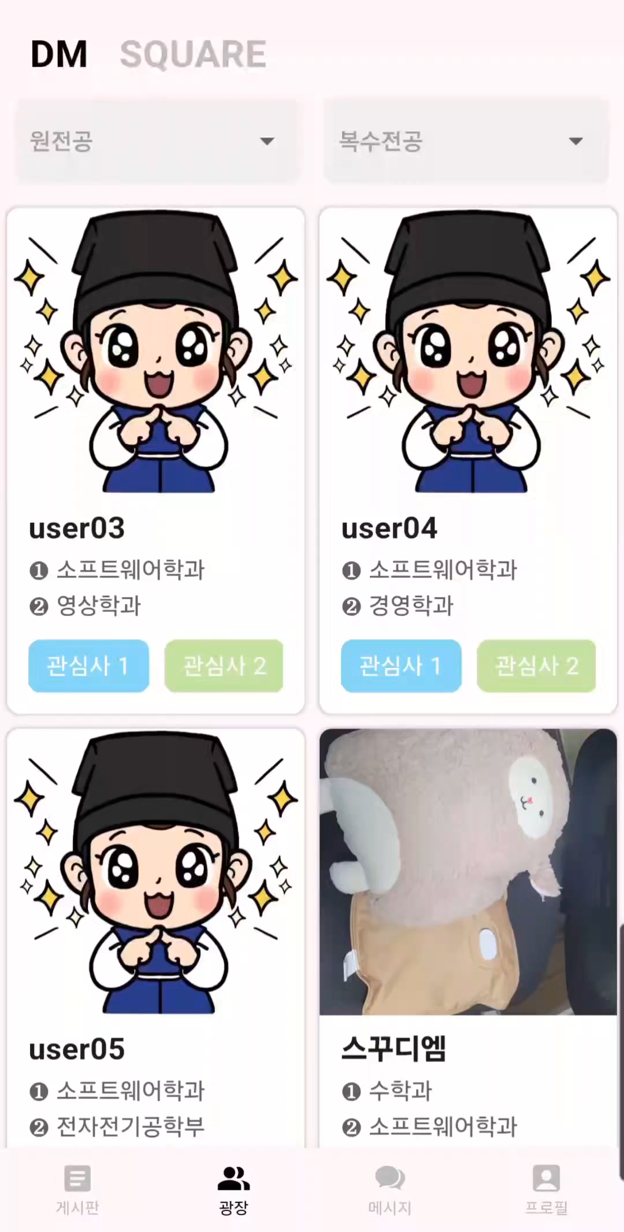
Private Profile
Messages
CHAPTER
04
Frontend with Demo
Notes:
This demo video is showing searching users by major and showing that if you change your profile to private, it's no longer on the DM list. This is demo video sending message to one of the users.

Slide 17
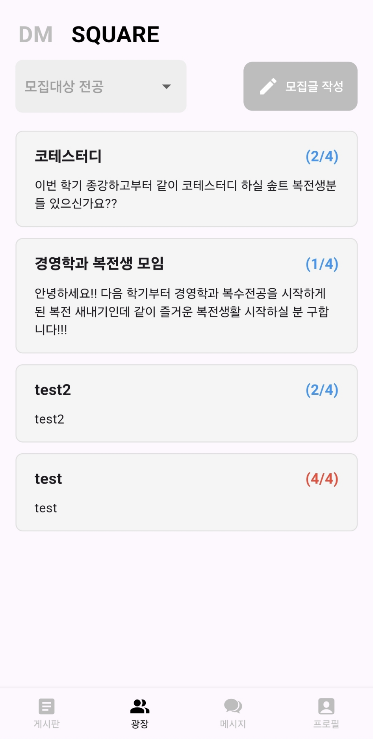
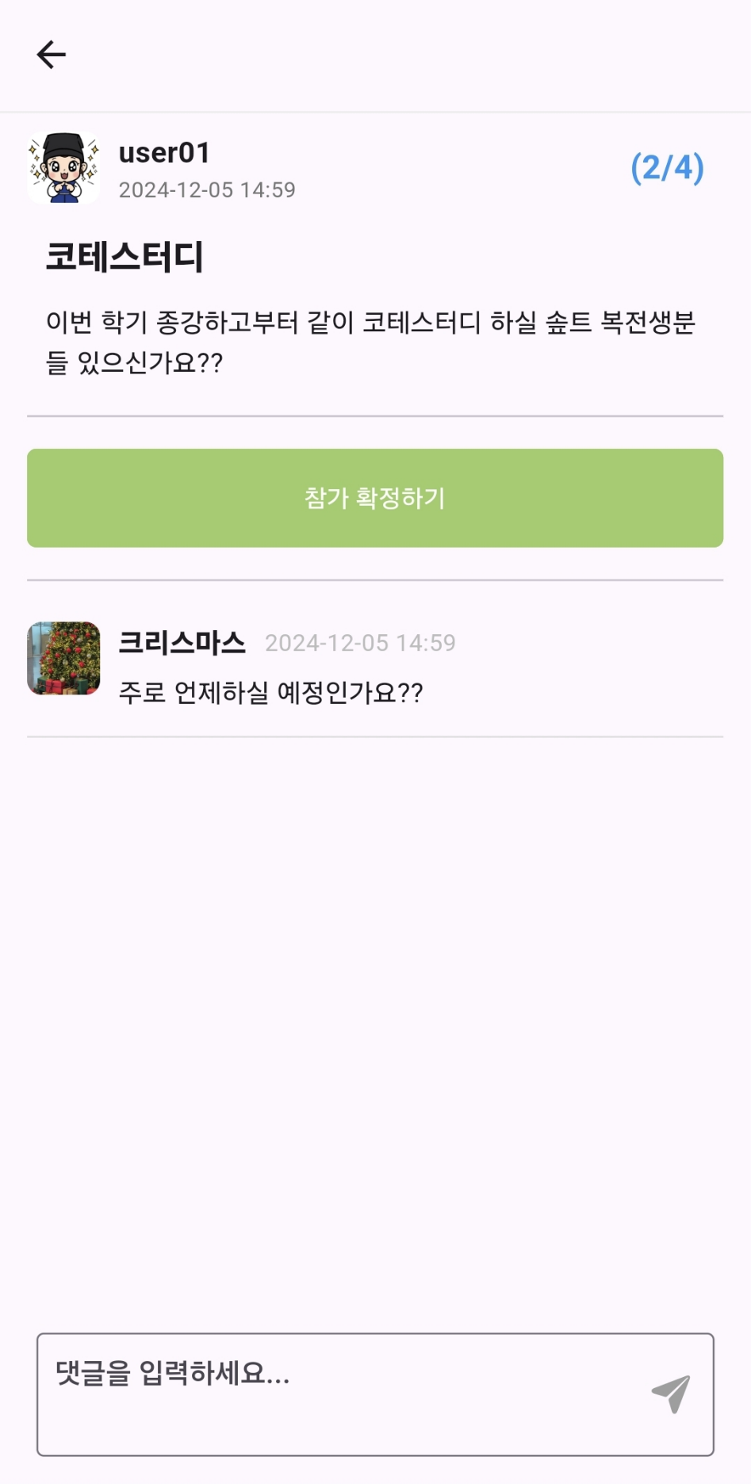

Square & Messages
CHAPTER
04
Frontend with Demo
Recruit small groups
You can write and search recruitments by major and ask some questions in comments before joining.
Join a group
If you carefully decide to join, you can enter the chat room for this group.
Notes:
If DM was for 1:1 interaction, square is a space where small groups with the same purpose or goal can be recruited for each major.
For example, some student is going to take the Capstone project next semester, and he or she can recruit students who want to team up with in advance.
Or we can recruit students who will study for the coding test together.
If you have any more questions about recruiting, you can ask in the comments before joining the group.
Then if you carefully decide to join, you will be able to join the group's chat.

Slide 18
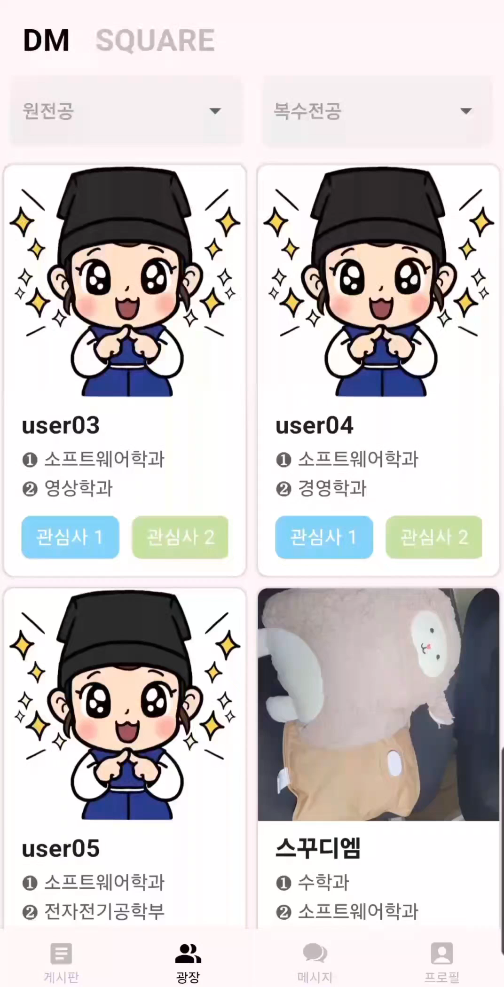
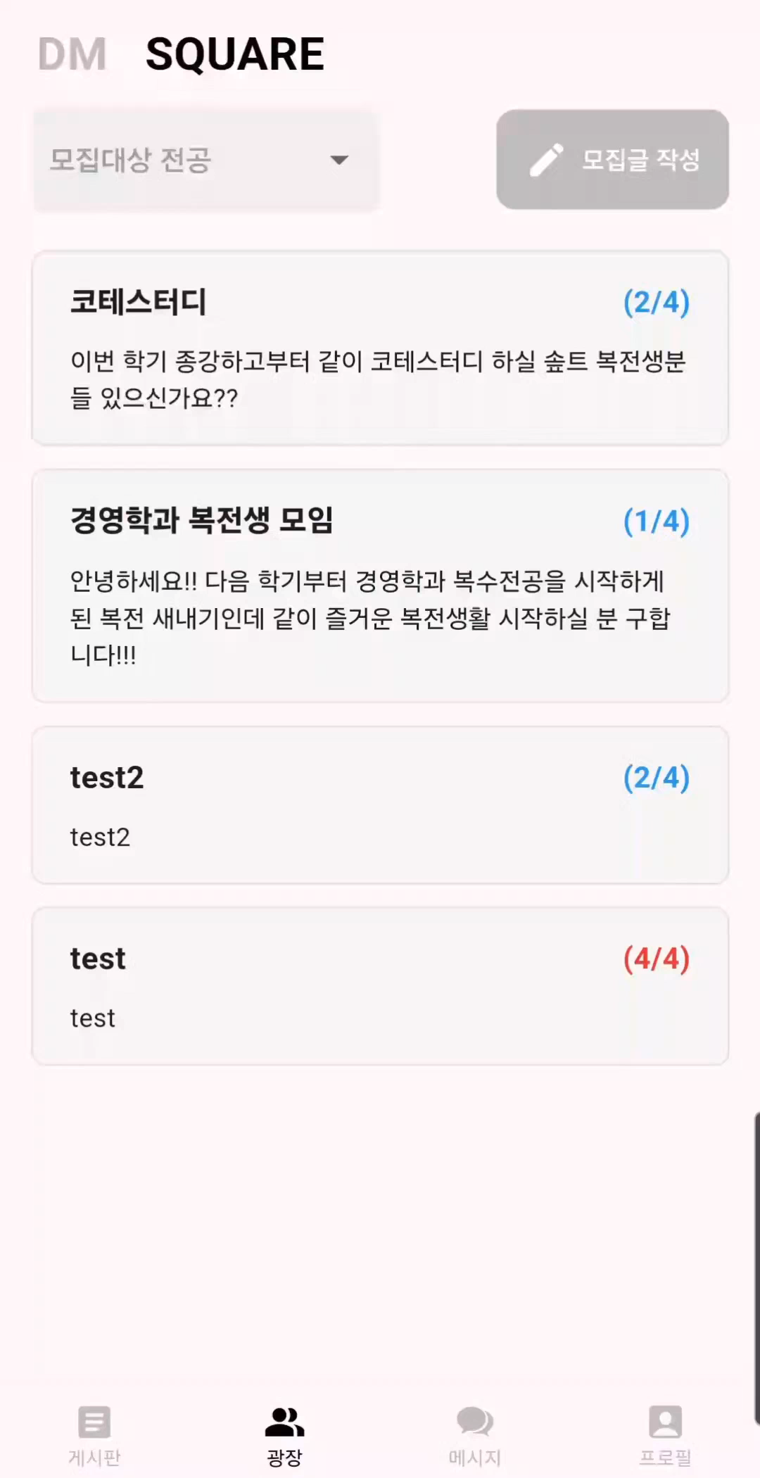
Square
Search by major
CHAPTER
04
Frontend with Demo
Notes:
This is demo video of square and searching by major.

Slide 19
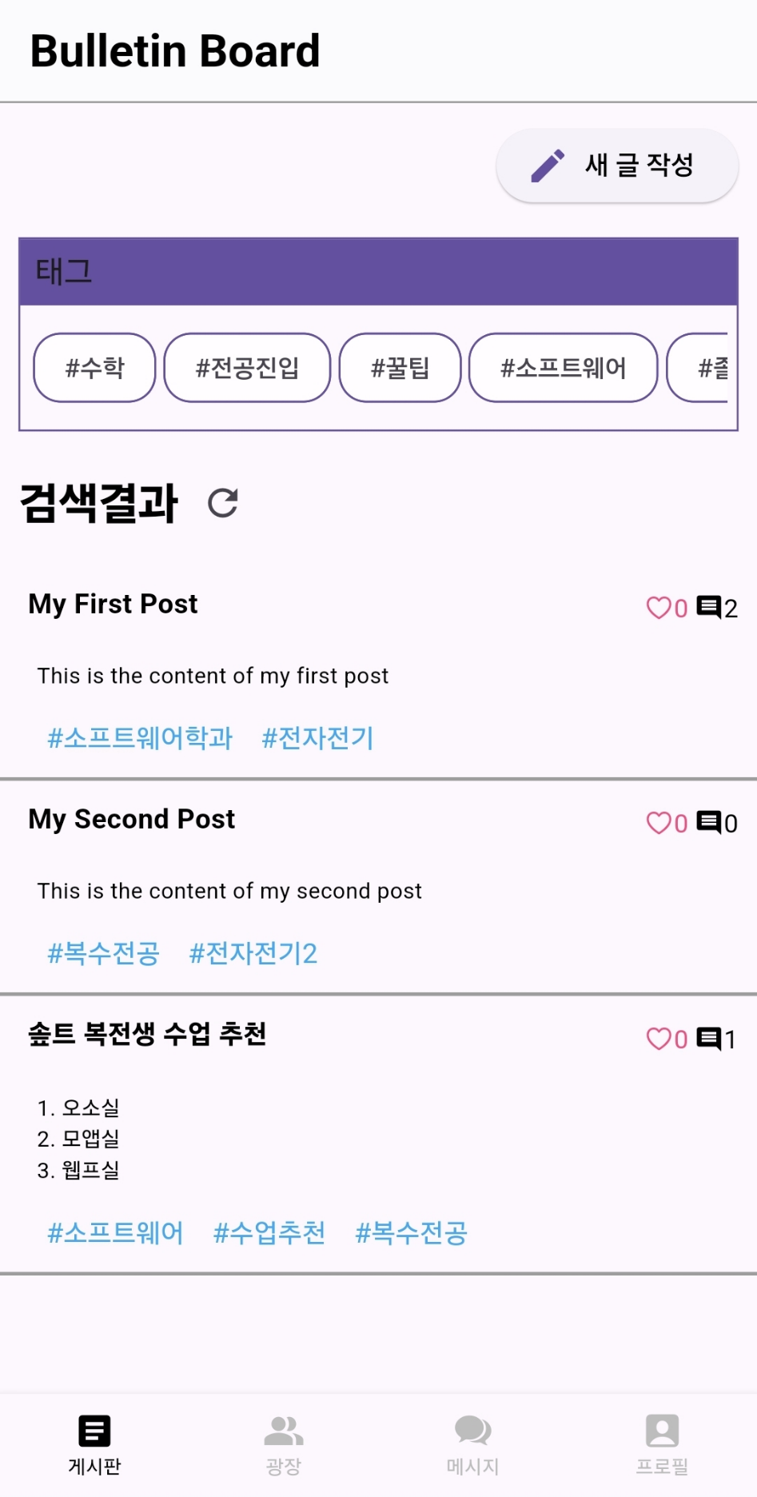
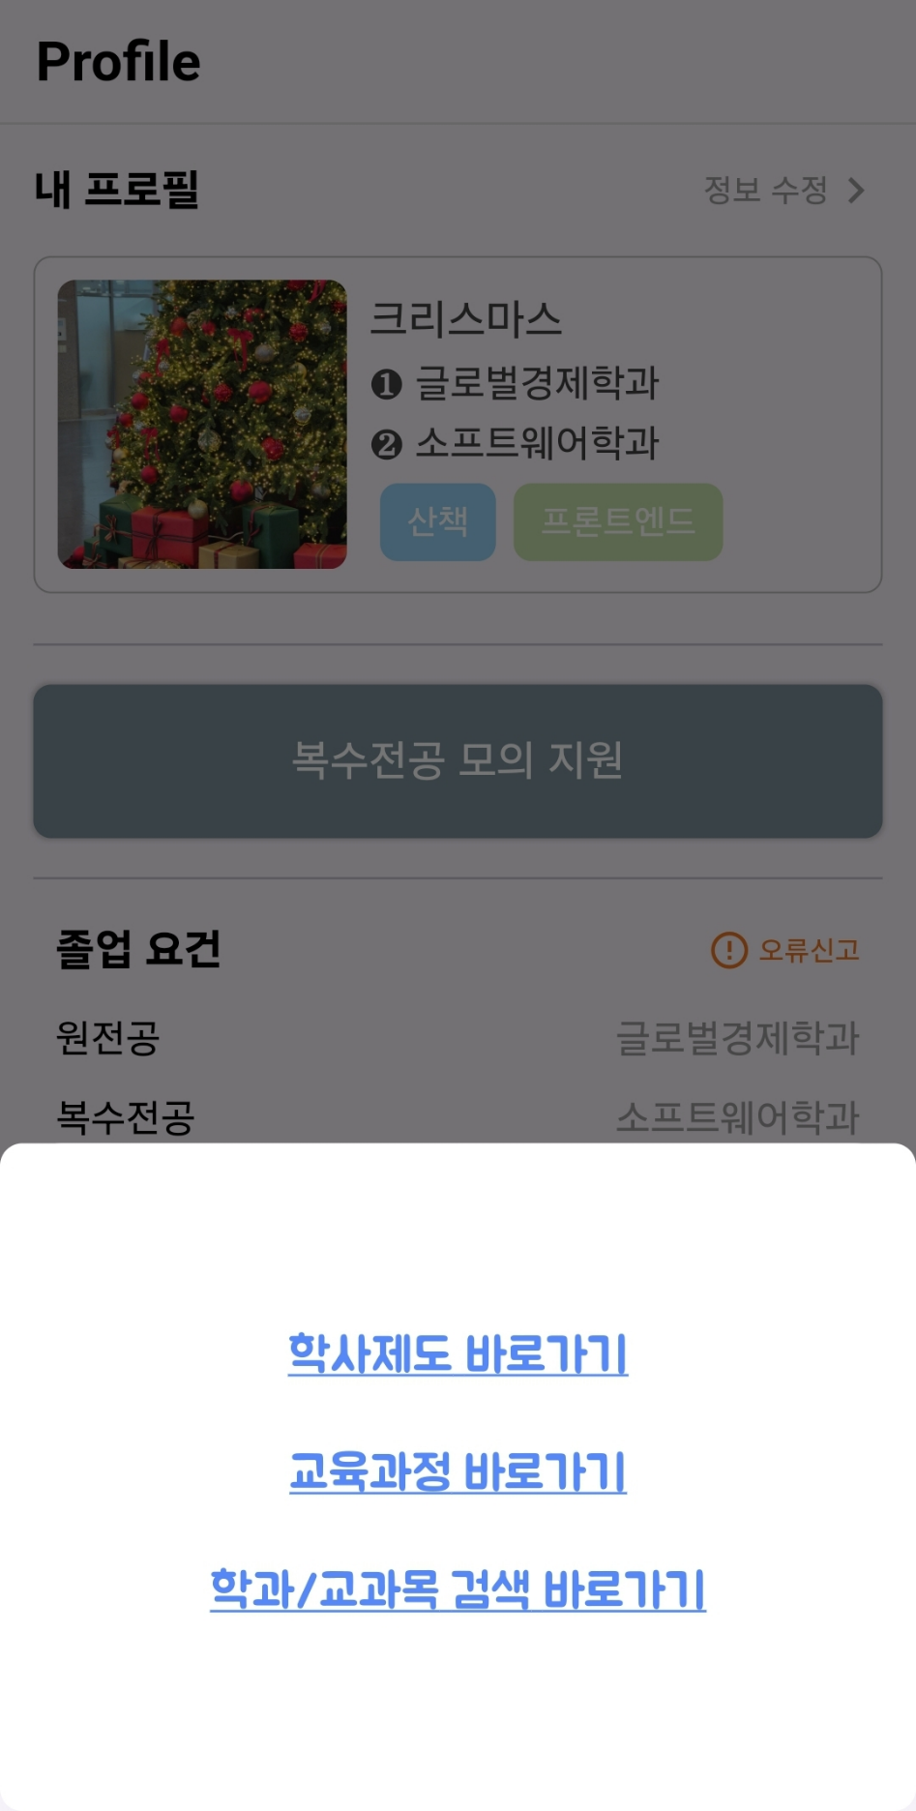


Bulletin board & Graduation info
CHAPTER
04
Frontend with Demo
Tag-based
Bulletin board
You can write and search about major information quickly based on tag.
Graduation
Information
You can go directly to the site that provides the graduation information.
Notes:
Finally, you can use tag-based information-specific bulletin boards and
go directly to site links that provide information necessary for graduation requirements.
In order to activate the informational bulletin board, we planned to force the users to write at least one post after signing up,
but this part was not applied due to time.

Slide 20
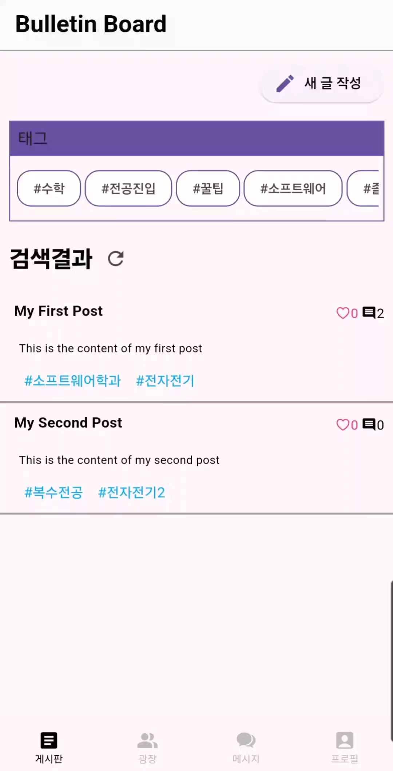
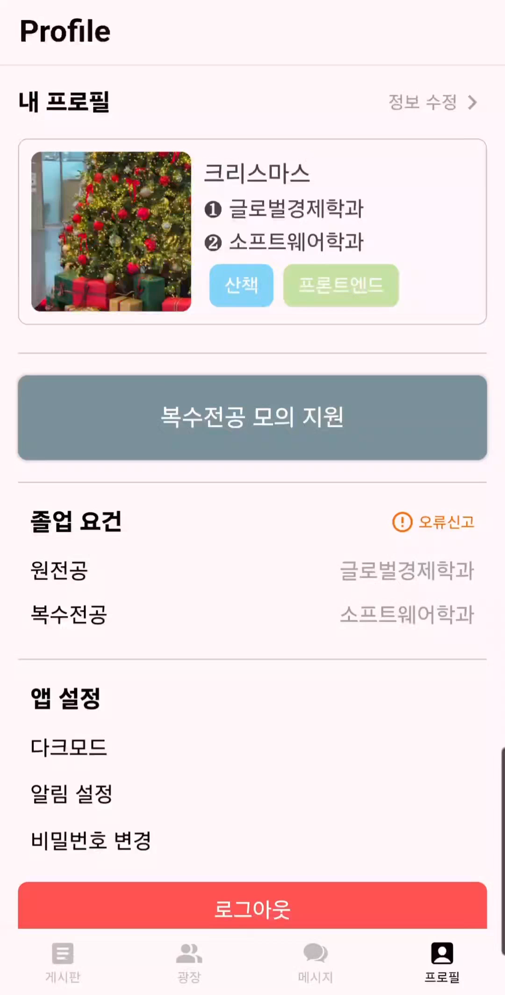
Bulletin Board
Graduation info
CHAPTER
04
Frontend with Demo
Notes:
This is demo video of bulletin board and graduation info.

Slide 21
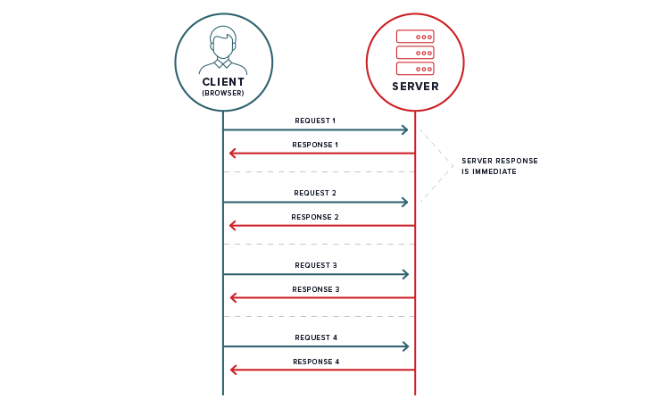
Chatting
CHAPTER
05
CHALLENGES
During Weekly Process #3
Our team has decided to implement chat using polling
Notes:
In the challenges section, I will explain the difficulties we encountered while implementing the chat functionality and our process for resolving them. Initially, during our third Weekly Progress Meeting, we decided to implement chat functionality using a simple polling approach.
We chose this method because it was the most straightforward implementation - sending requests to the server approximately every second to fetch chat-related data.

Slide 22
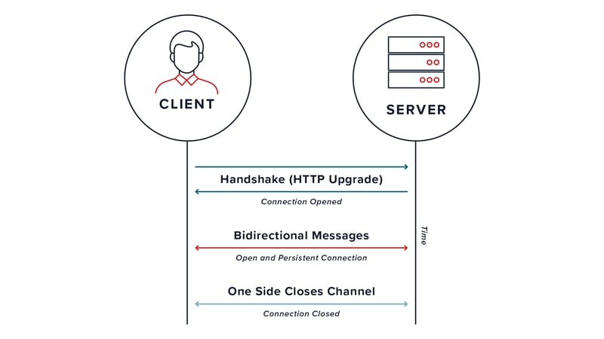
Chatting
CHAPTER
05
CHALLENGES
After receiving professor’s feedback, we are attempting to implement using WebSocket instead
but handling HTTP request and WebSocket on same server is difficult..
Notes:
However, after receiving feedback from professor suggesting we explore alternatives to polling,
we decided to implement the chat functionality using WebSocket, which is a common approach for real-time chat applications.
Yet, implementing both WebSocket and HTTP requests within the same NestJS server proved challenging due to various issues, including authentication concerns.

Slide 23

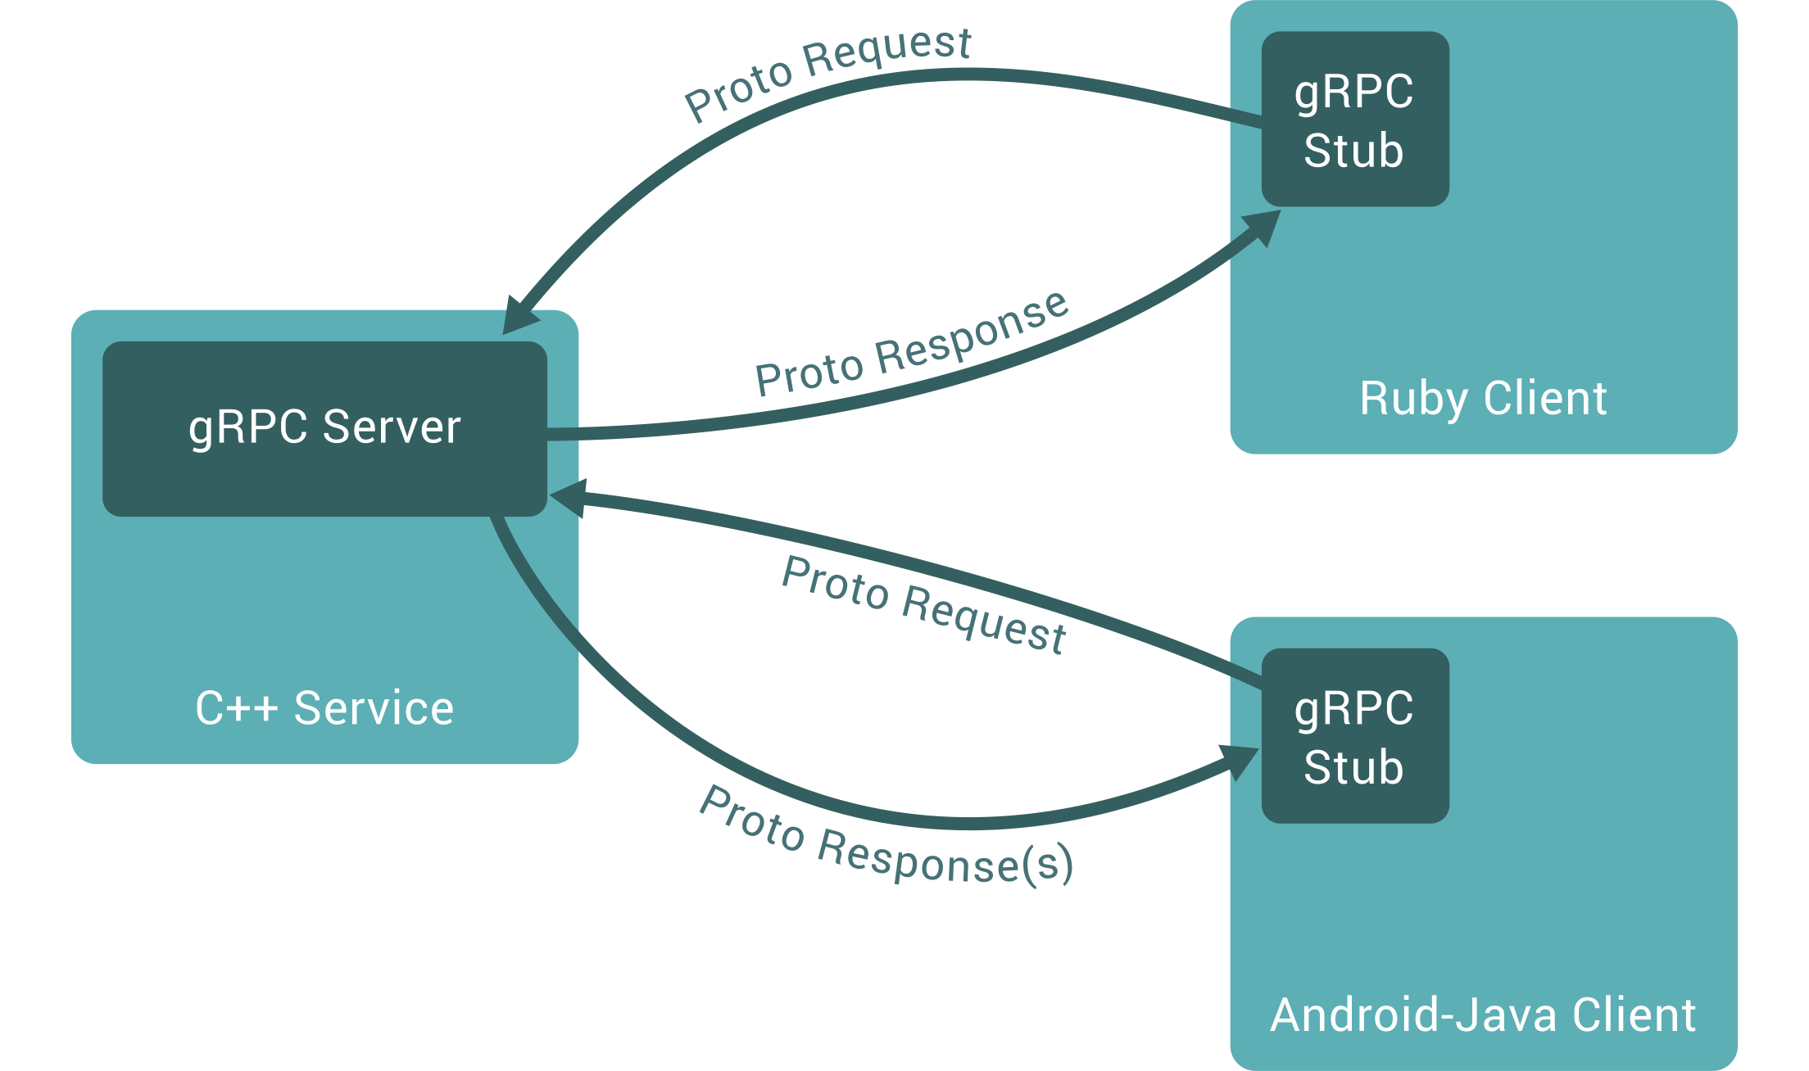
Chatting
CHAPTER
05
CHALLENGES
We implemented the chat functionality using Firebase and related Flutter libraries, which support gRPC protocol, enabling easy implementation of bidirectional communication.
Notes:
After exploring various options, we discovered FireStore, which has built-in gRPC protocol support for bi-directional communication.
Using FireStore and its Flutter library, we were able to implement the chat functionality relatively easily.
For implementation details, we used information from JWT tokens to identify which user was sending each chat message.

Slide 24
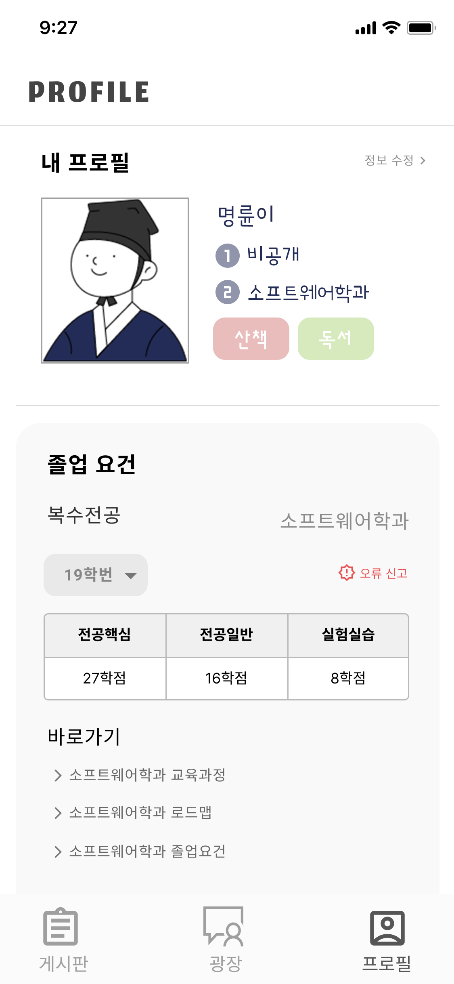

Partially Implemented - Graduation info
CHAPTER
06
Limitations
Provide personal graduation info
We tried to provide customized graduation info for each major and student number at the first time.
Provide direct URL
Faced with the difficulty of automatically organizing files organized by pdf, we replaced providing the web link of the site with the information.
Notes:
Let me explain the limitations of our project.
Initially, we planned to provide graduation requirements information by collecting students' department and student ID information. However, we faced two key challenges:
1. We were unable to find a method to automatically fetch graduation requirements that change annually
2. We struggled to collect existing graduation requirement information effectively
As a result, we scaled down this feature to simply display hyperlinks directing users to relevant information sites instead of providing the comprehensive graduation requirements system we originally envisioned.

Slide 25


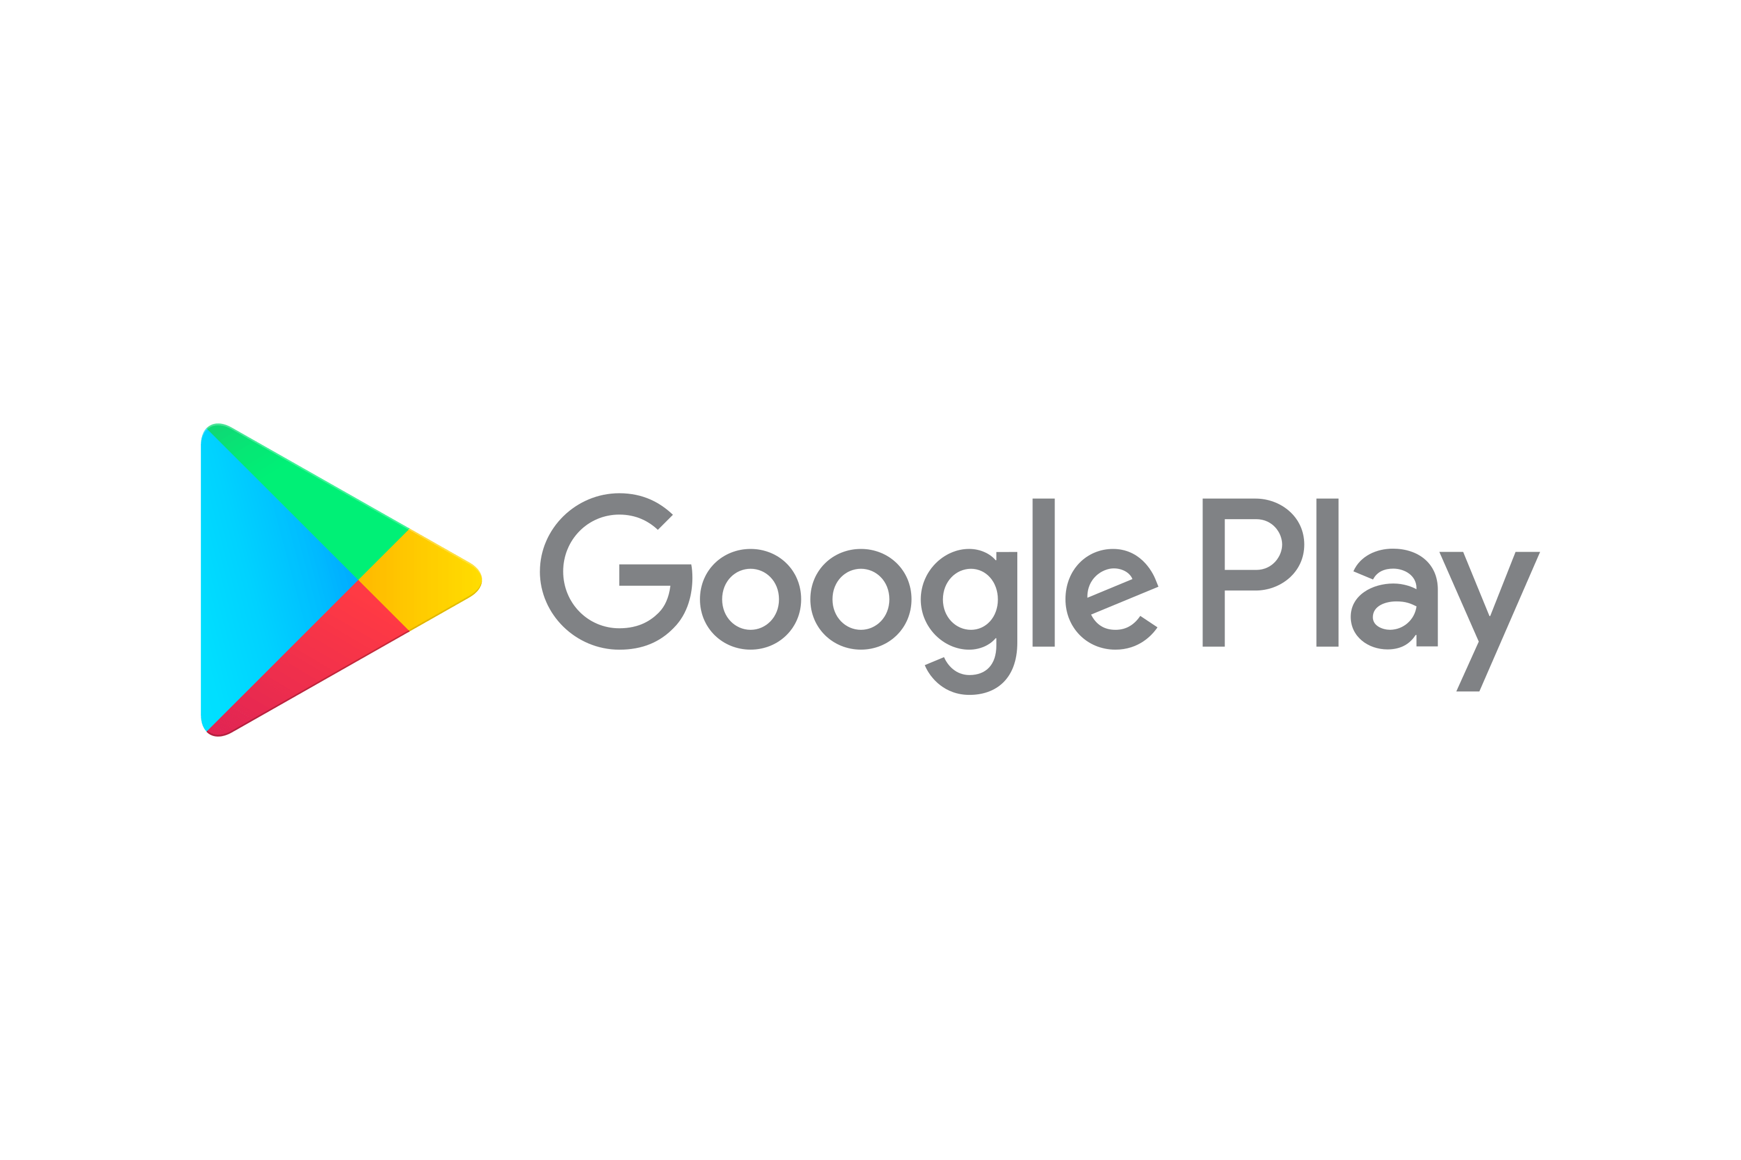
Not Implemented
CHAPTER
06
Limitations
Mock Apply
Marketplace Deploy
Notes:
Additionally, we were unable to implement the dual major application simulation feature and publish the application to app stores due to time and budget constraints.

Slide 26

CAPSTONE DESIGN PROJECT
THANK YOU!
Notes:
Thank you

